Slide 1

603-Quantitative Analysis of Financial Markets Project Presentation
Group 9：Ruoyao LI, Sinuan LI, Tingjia LU, Yang HONG,
Yonghan ZHANG, Zuoyu XIE, Anirudh Krishnan

Slide 2
Objective
Objective: Forecast liquidity risk for banks by predicting “Total Loans to Total Deposits” ratio to assess and manage bank’s liquidity risk effectively. Our analysis was done for multiple banks both small and large, but will focus more on FRCB (First Republic Bank) which went bankrupt in May 1 (Q2) 2023.
Why Forecast this measure?
Critical Liquidity Health Indicator
Early Warning Signal
Regulatory Benchmark
Comprehensive Measure
Models for Forecasting?
OLS: Baseline model to capture predictor relationships
ARIMA: Models temporal trends in the liquidity indicator
VAR: Captures interdependencies among predictors
VECM: Accounts for long-term equilibrium relationships
Why these Models?
Comprehensive Analysis: Combines regression and advanced time series methods.
Robust Comparison: Assess model performance for accurate forecasting
Enhanced Predictive Power: Utilizes the strengths of each model

Slide 3
Research Introduction
Research objectives：Forecasting the Future Risks of Major U.S. Banks.
Research subjects：Bank of America Corp/ Citizens Financial Group Inc/ FIFTH THIRD/ JPM US CHASE/ USB US Equity/ WFC US Equity
FCNCA US Equity (acquired the failed Silicon Valley Bank in Mar 2023)
FRCB US Equity (had declared bankruptcy in 2023)
Research data: Net Loans(millions) Reserve for Loan Losses(millions)
Total Deposits(millions) Provision for Loan Losses(millions)/
Total Loans(millions) Non-Performing Loans(millions)/
Total Loans to Total Deposits(%) FED FUNDS(Fed funds rate)
CPI (Consumer Price Index ) UN RATE(Unemployment Rate)
REAL GDP(Gross Domestic Product)
obtained from Bloomberg and the Federal Reserve, covering quarterly data over a nine-year period

Slide 4

Date Gathering
Bloomberg
Macroeconomic Data:
Unemployment Rate:
Increased loan defaults
Higher credit risk for banks
Federal Funds:
Affecting the cost of borrowing
Liquidity and profitability
Bank-Specific Variables:
Non-Performing Loans
Loan Loss Provisions

Slide 5
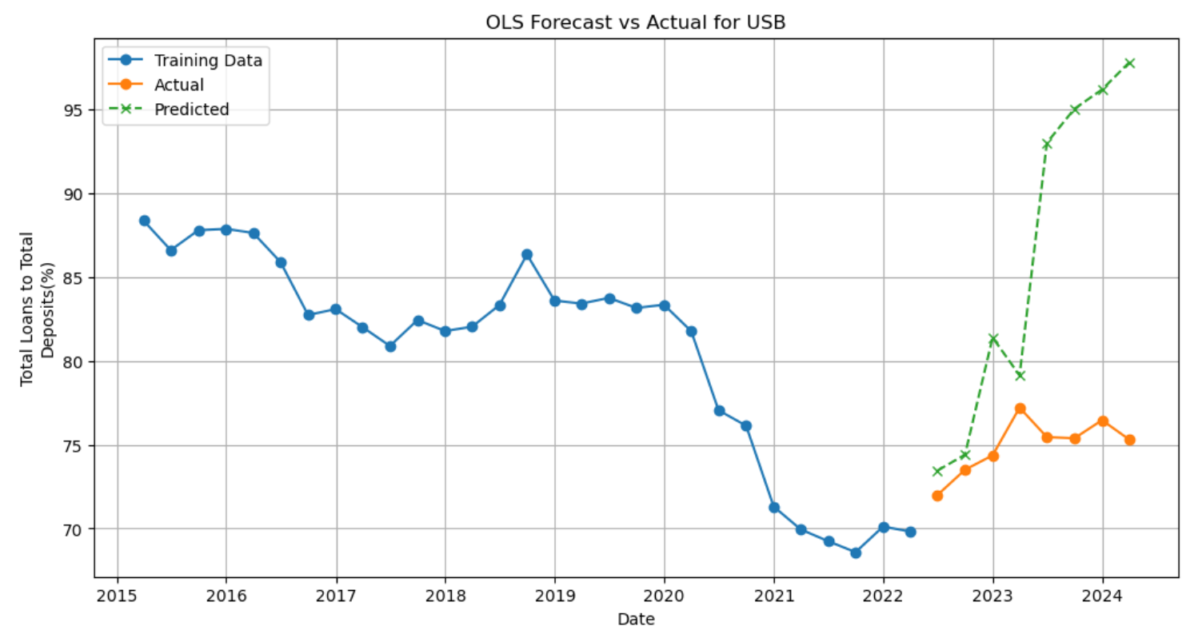
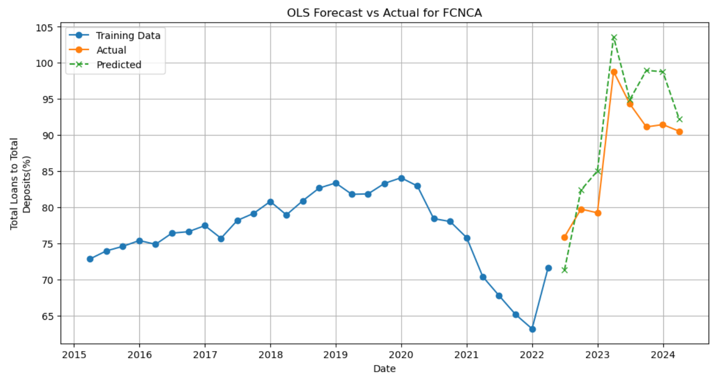
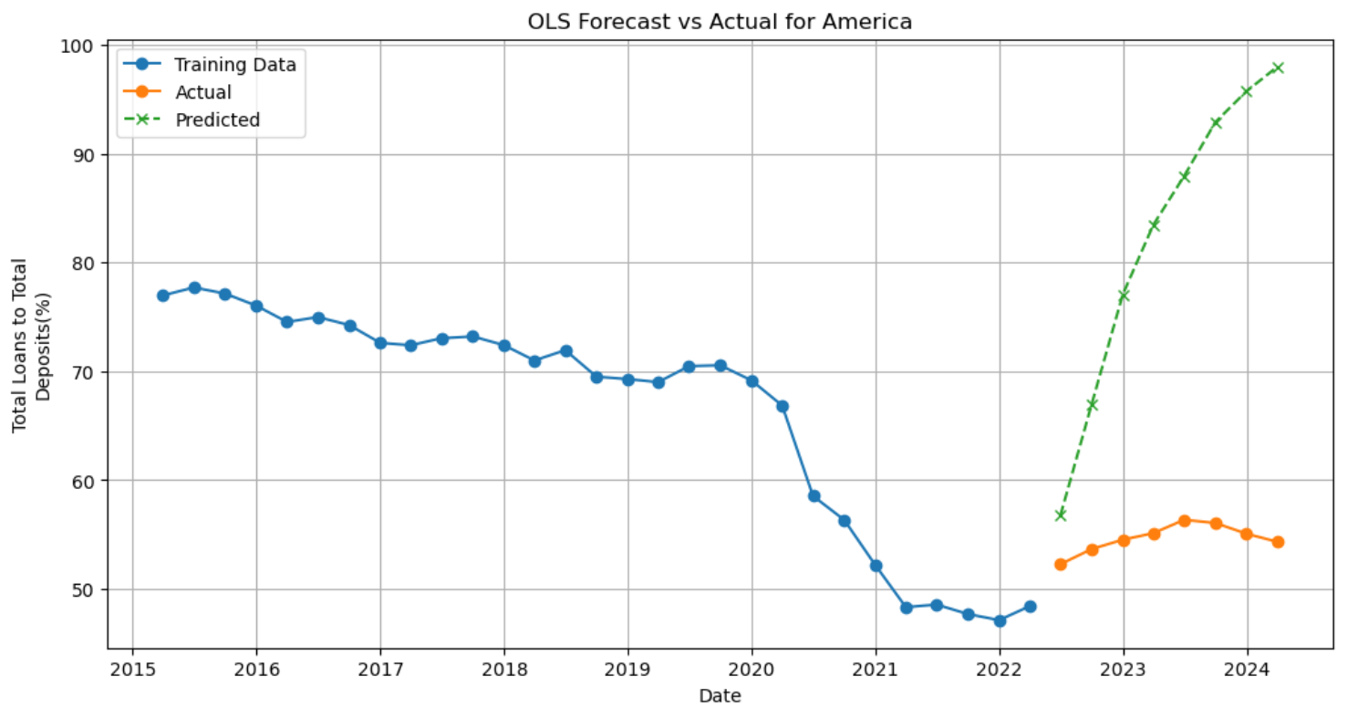
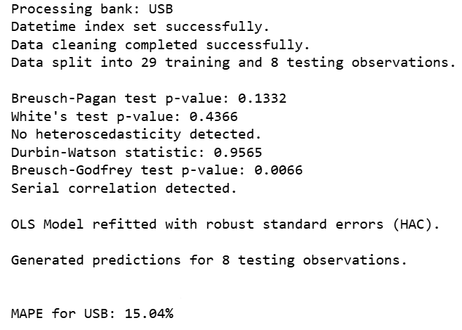
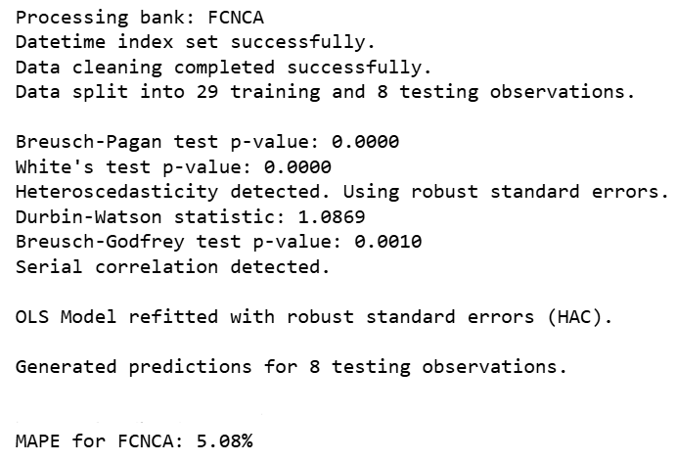
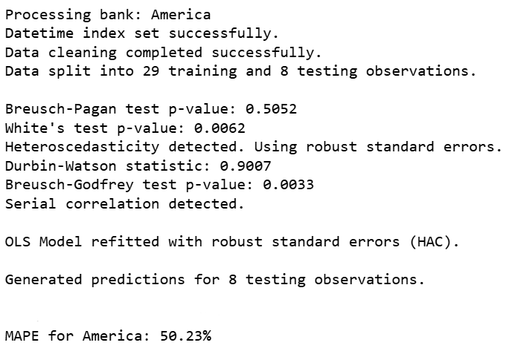
OLS Regression
1. What we do
2.show some graph fo all banks
3.rmse and maps on the test set
4.explain why the performance is good or not
USB FCNCA Bank of America Corp

Slide 6
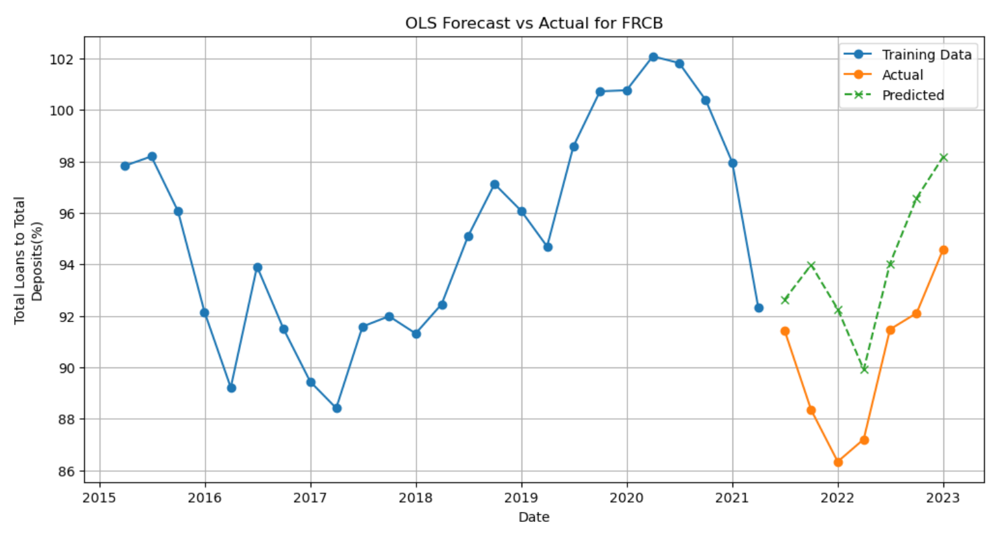
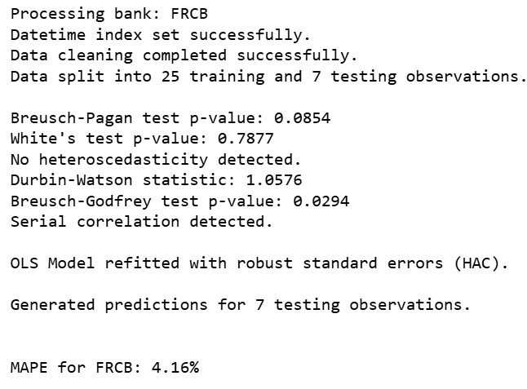
OLS Regression
FRCB US Equity:
Durbin-Watson：strongly suggests the presence of positive autocorrelation, this is typical of time series data.
Condition Number: serious multicollinearity issues.
Introduction of Macroeconomic Variables: suggests that time-related factors are important in explaining changes

Slide 7
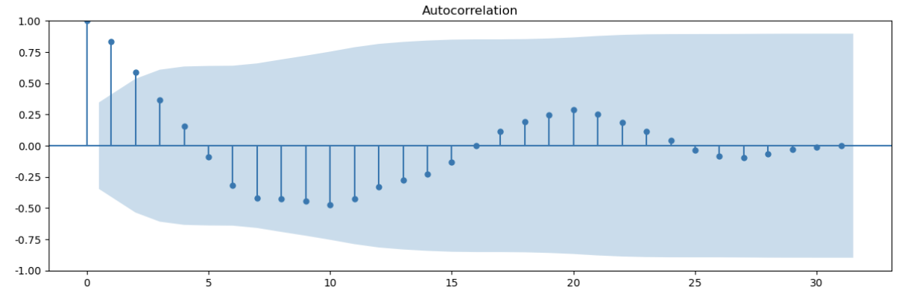
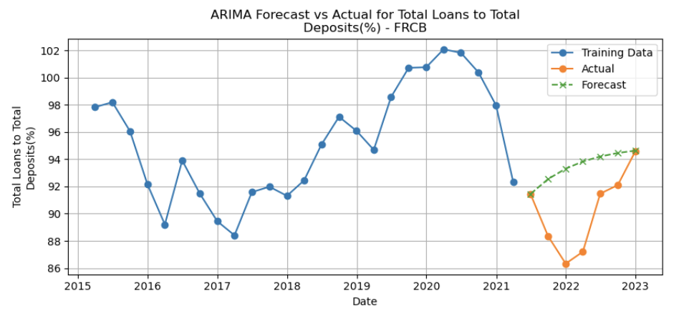
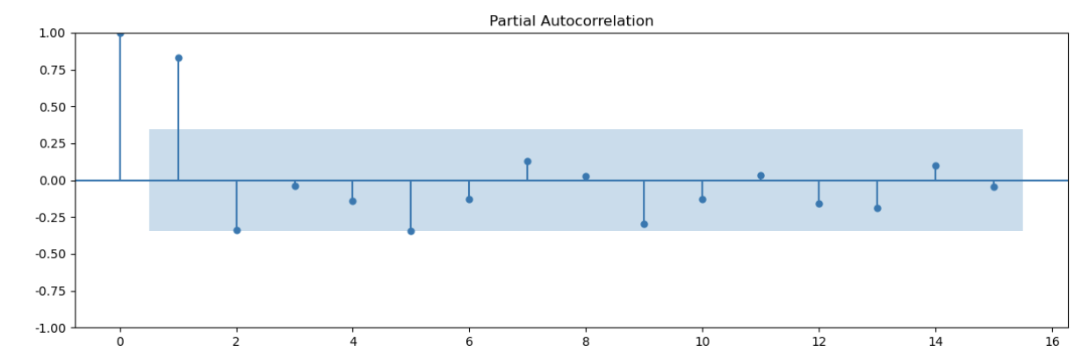
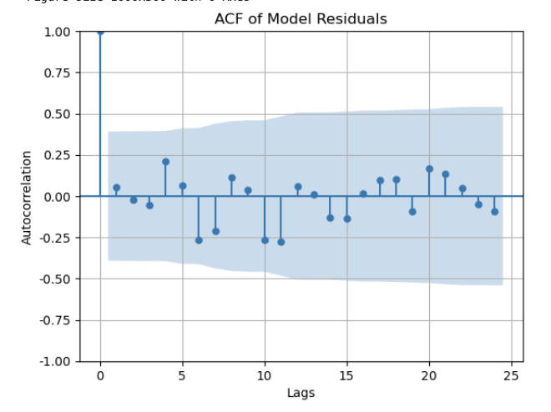
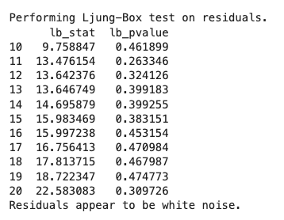
Comprehensive Analysis of ARIMA Models（FRCB）
ACF
ARIMA(0,1,0)
FORECAST
PACF
Ljung-Box Test

Slide 8
Comprehensive Analysis of ARIMA Models（FRCB）
Interpretation of Metrics:
RMSE (4.20): Here, an RMSE of 4.20 suggests the forecast deviates from the actual values by around 4.2 percentage points on average, which is relatively low.
MAPE (3.73%): MAPE indicates the percentage error on average between the forecasted and actual values. A MAPE of 3.73% is quite low, indicating good predictive accuracy, as MAPE values below 5% are generally considered excellent in time series forecasting.
Performance Interpretation:
Trend Alignment: The ARIMA model captures the overall trend well, initially aligning with the downward trend in the actual values. However, the model's upward trend in the forecast period is somewhat shallower than the actual recovery observed in 2022 and 2023.
Forecast Accuracy: The small deviations indicate that the ARIMA model is relatively accurate, but it slightly underestimates the sharpness of the upward trend in 2022. This underestimation is visible as the actual data rises more steeply than the forecasted data.

Slide 9
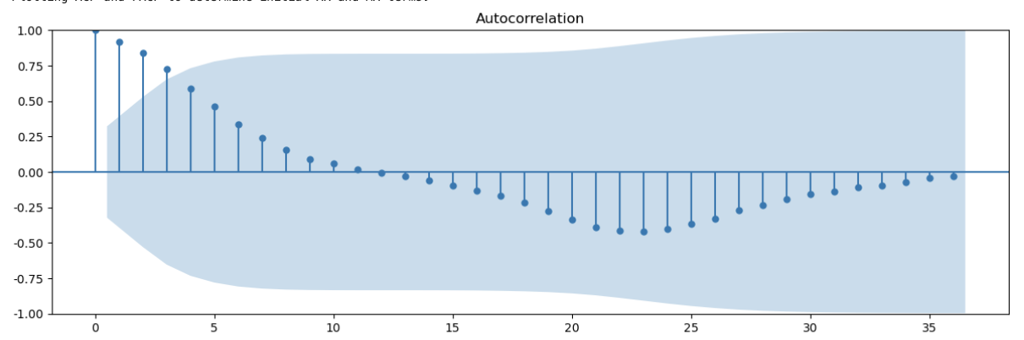
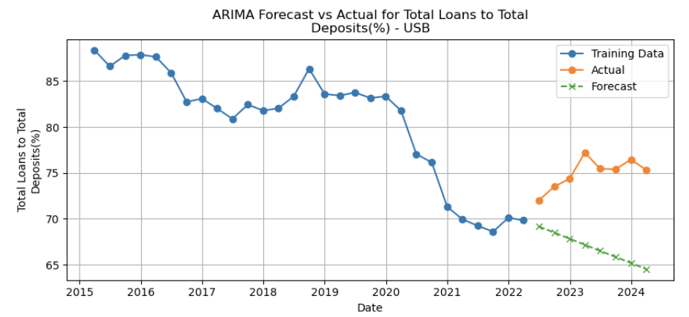
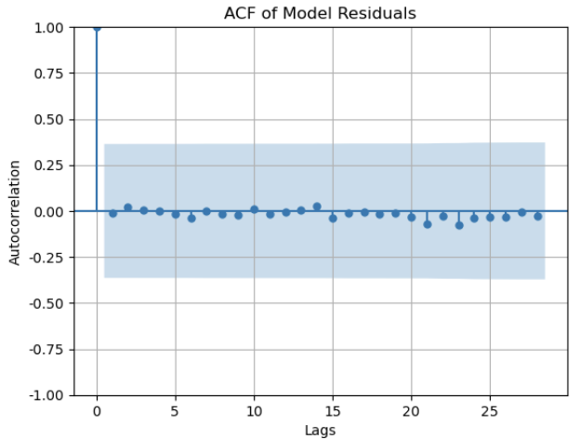
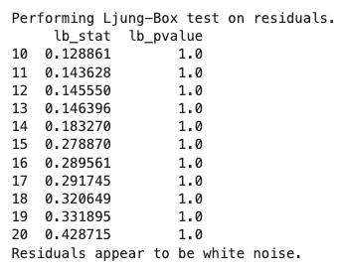
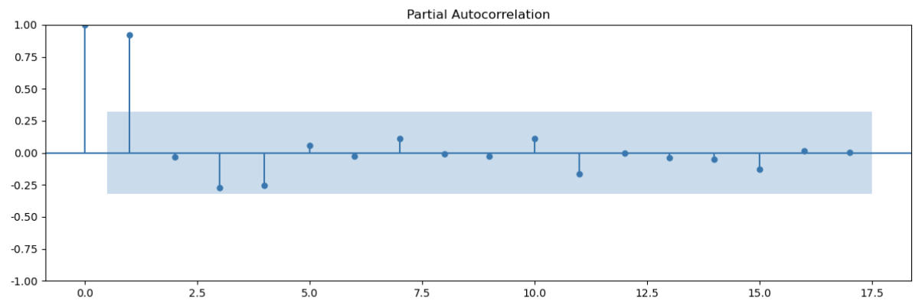
Comprehensive Analysis of ARIMA Models（USB）
ACF
ARIMA(0,1,0)
FORECAST
PACF
Ljung-Box Test

Slide 10
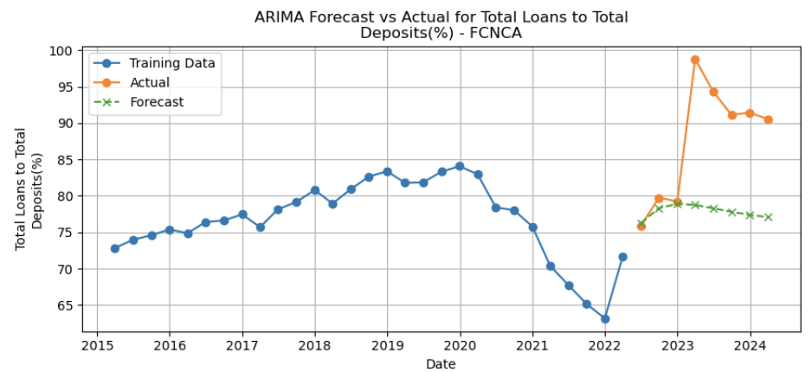
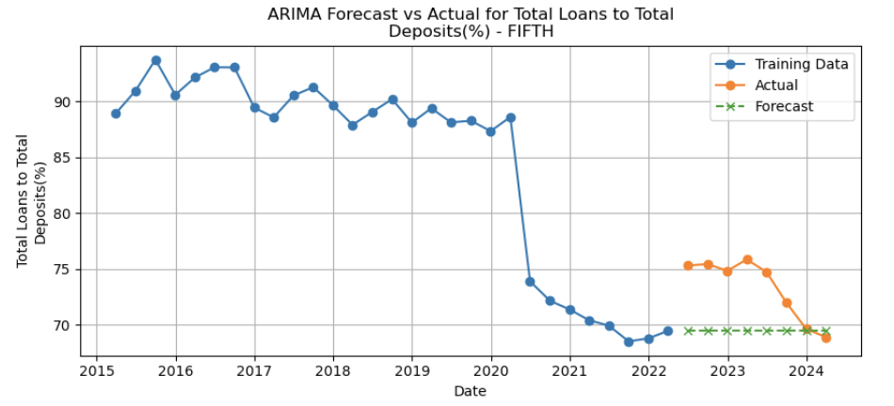
Compare
· FCNCA
· FIFTH THIRD
forecast
forecast
model
In conclusion, through ACF and PACF analysis, Ljung-Box test and Forecasts, ARIMA model has some shortcomings and has some room for improvement.
Next, we will show the VAR and VECM Models for predicting more accurately.

Slide 11
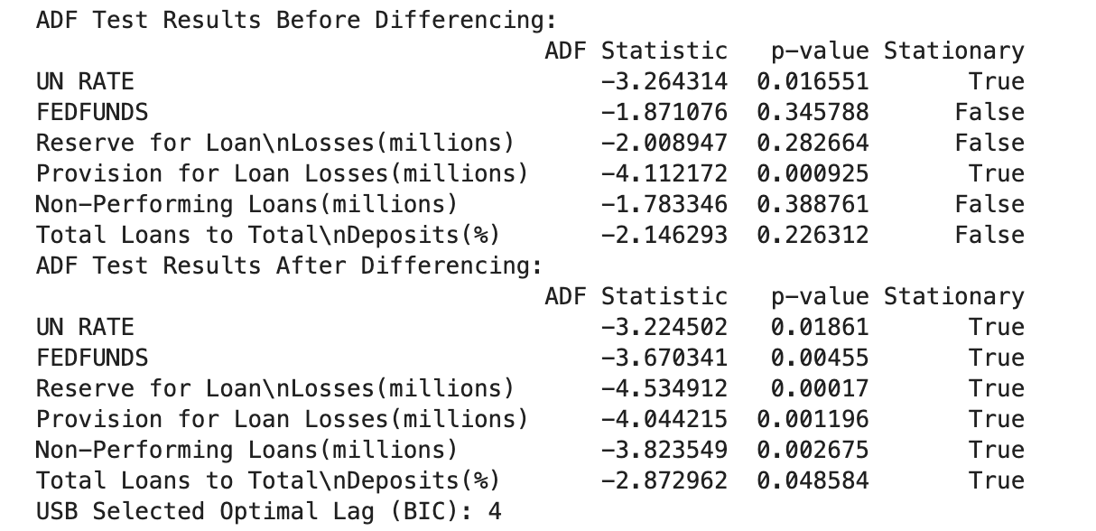
VAR（data of USB）
ADF test & use BIC
1. Data Preparation and Differencing
[80:20] Data Split : USB Bank
Augmented Dickey-Fuller (ADF) test;
differencing to variables until they became stable
2. Selection of Lag Order
a good balance between fitting the data well and keeping the model simple

Slide 12
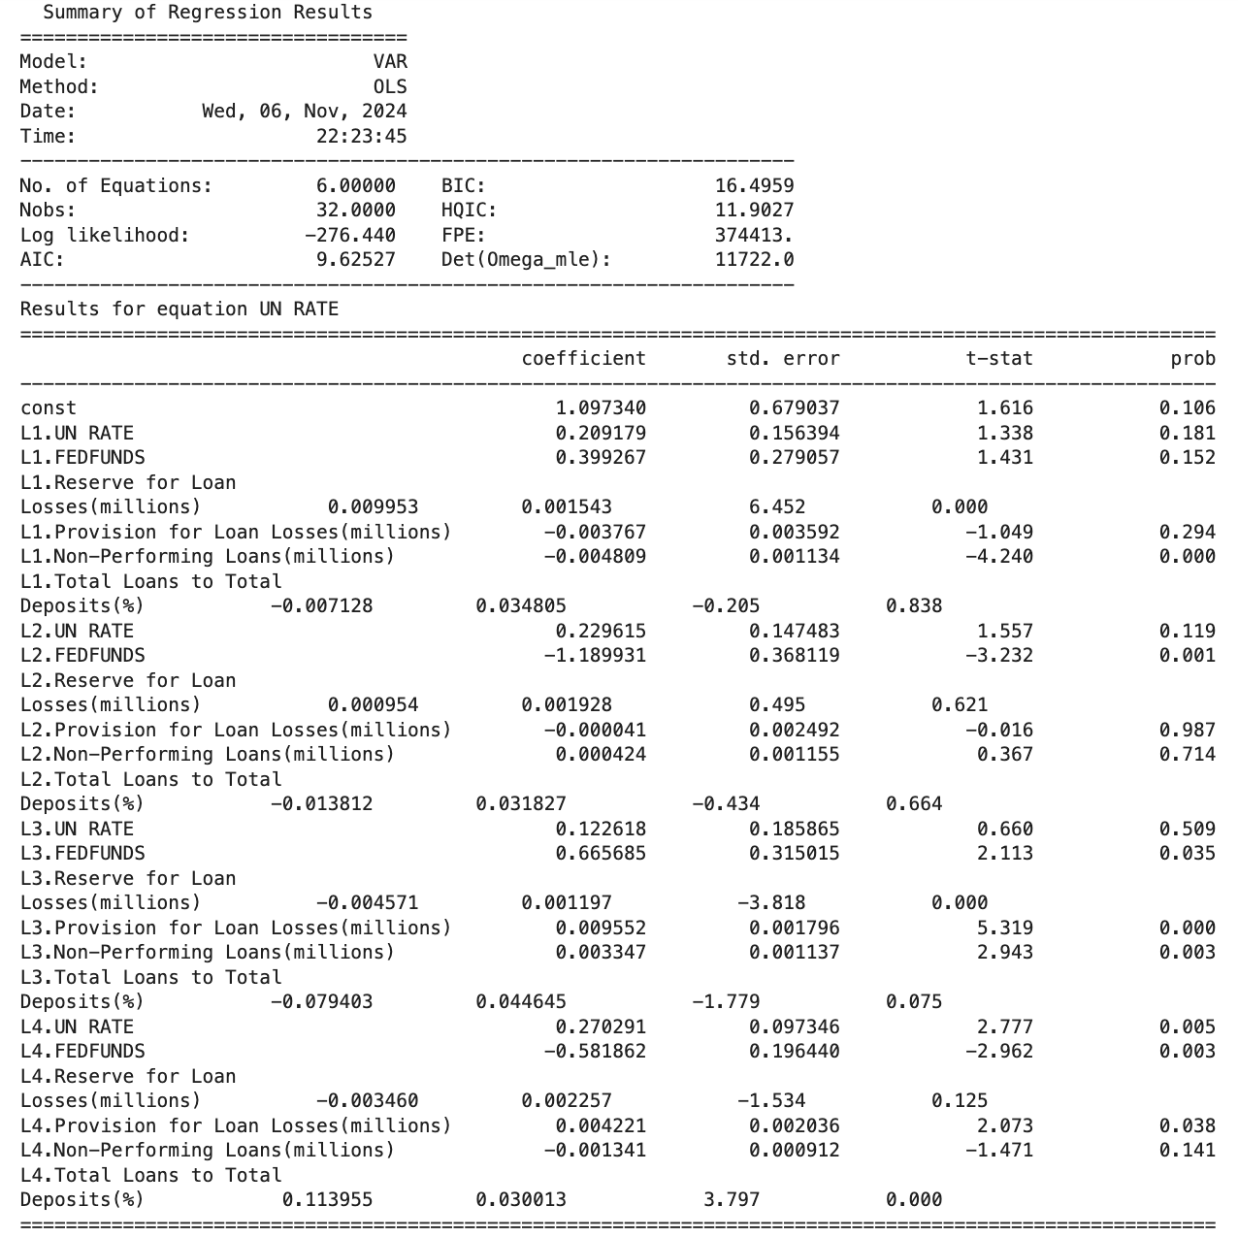
VAR（data of USB）
VAR model
3. Model Training and Parameter Estimation
Reserve for Loan Losses: When reserves go up, the LDR often goes down, meaning more reserves might reduce lending.
Non-Performing Loans (NPLs): Higher NPLs affect the LDR, showing how liquidity risk can impact loan strategy.
Federal Funds Rate: Has a mixed effect on LDR—raising the rate lowers LDR after 2 and 4 periods but increases it after 3 periods, showing a delayed, back-and-forth impact.

Slide 13
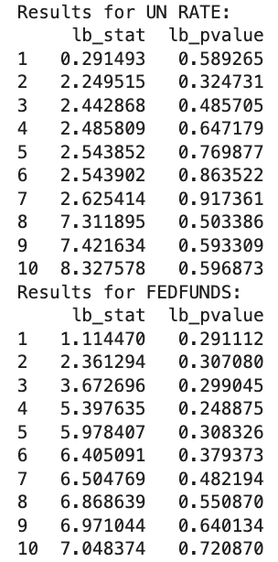
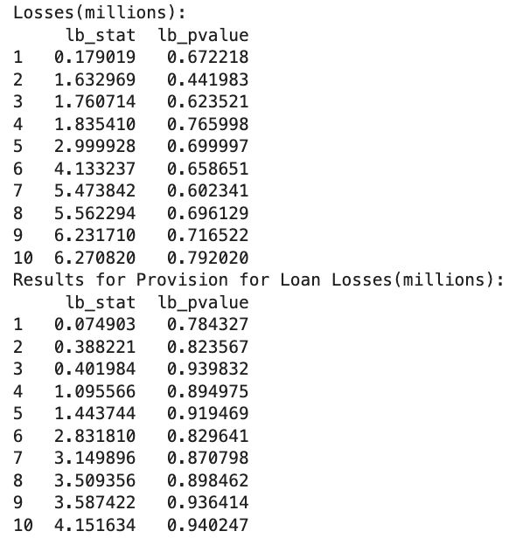
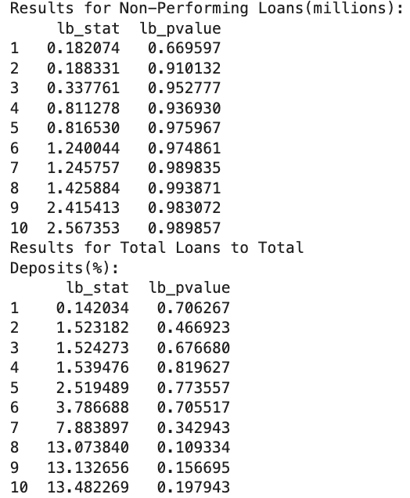
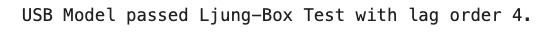
VAR（data of USB）
Ljung-Box Test
4. Independence Test of Model Residuals
The test showed that with a lag order of 4, the model passed, meaning the errors were independent enough.

Slide 14
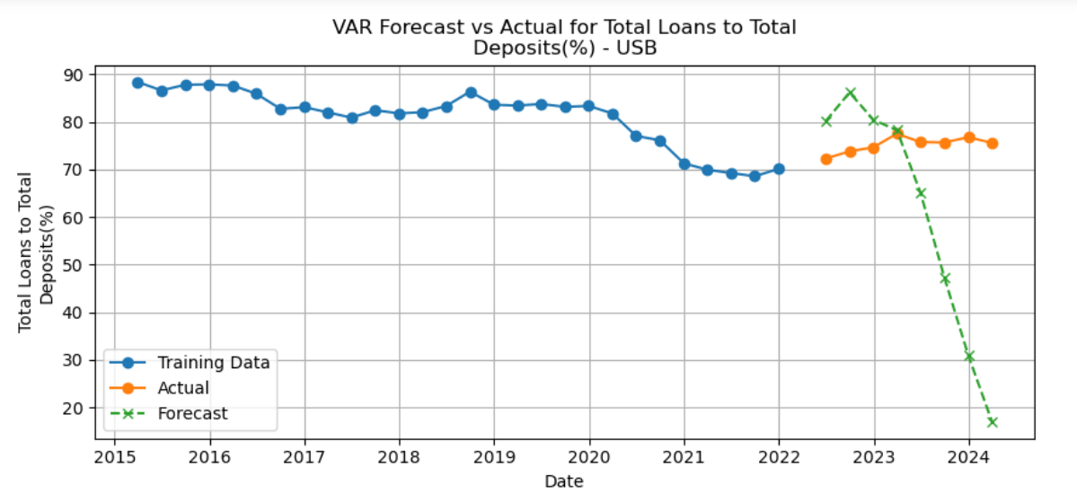
VAR（data of USB）
Forecast
5. Generating Predictions Based on the Test Set: compared the predicted results with actual values

Slide 15
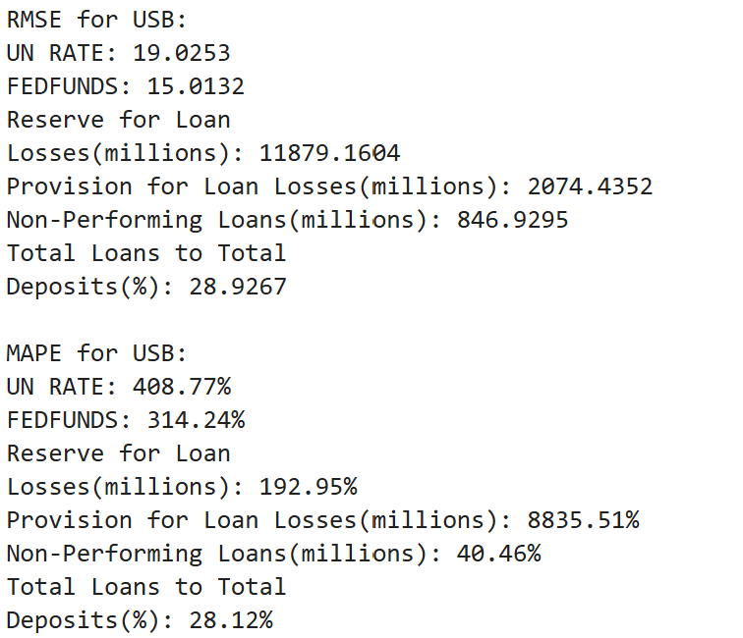
VAR（data of USB）
Error
6. Error Evaluation
Low RMSE and MAPE values mean the model’s predictions were close to the actual LDR values in the test data.

Slide 16
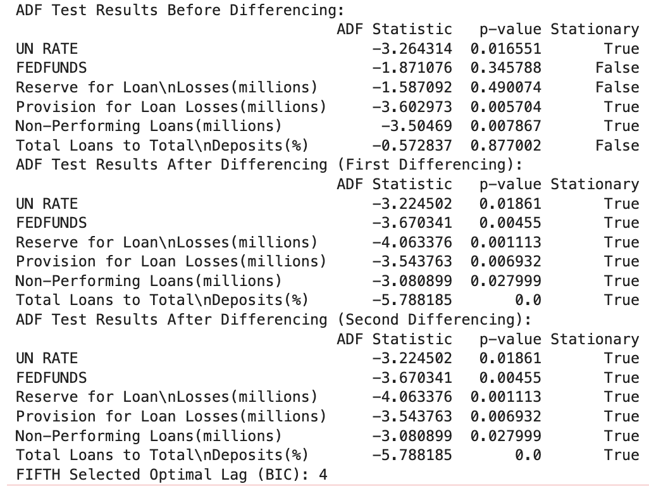

VAR（data of FIFTH THIRD）
ADF test & use BIC for initial order
The ADF test shows that all variables become stationary after the first differencing, and the optimal lag order is selected as 4 based on BIC.

Slide 17
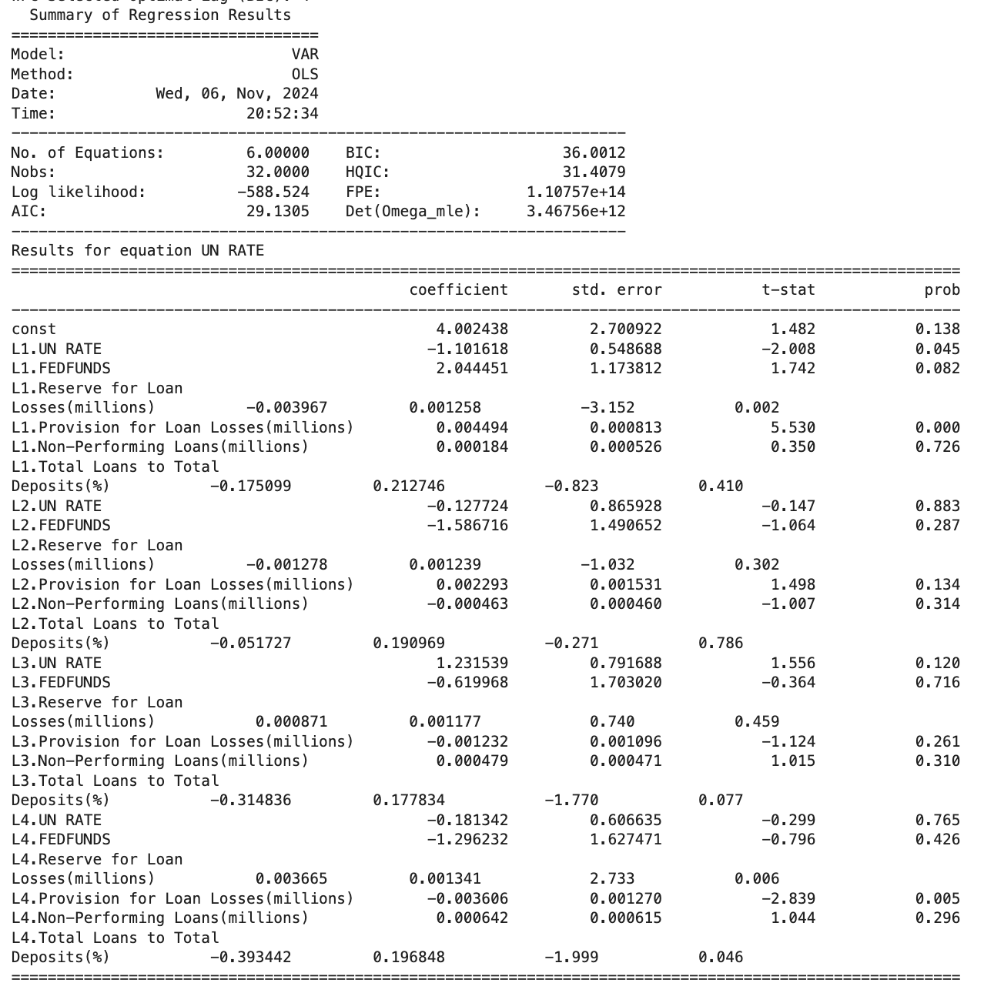
VAR（data of FIFTH THIRD）
VAR
The VAR results indicate that some variables, like "Provision for Loan Losses (millions)" at lag 1, have a significant impact on UN RATE.

Slide 18
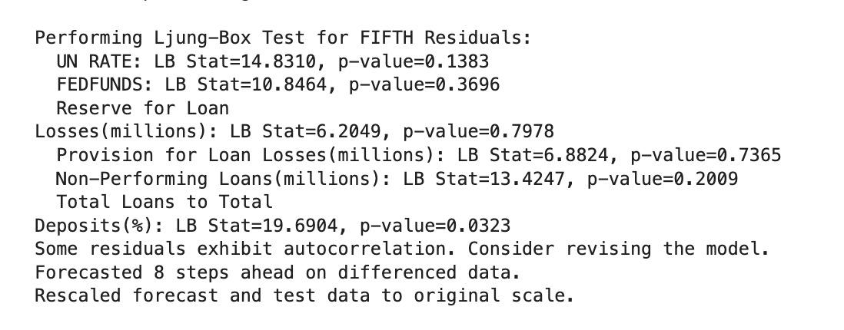
VAR（data of FIFTH THIRD）
Ljung-Box Test
The Ljung-Box test for FIFTH THIRD shows a good model fit.

Slide 19
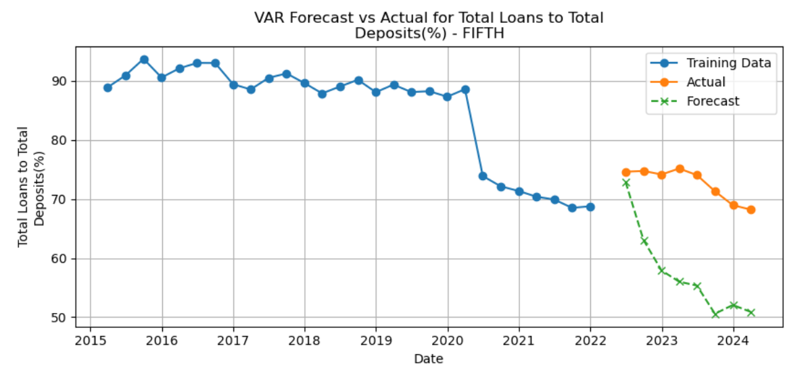
VAR（data of FIFTH THIRD）
Forecast
The forecast results for FIFTH THIRD show a promising trend alignment for some variables, though certain deviations suggest that refining the model could further enhance its predictive accuracy.

Slide 20
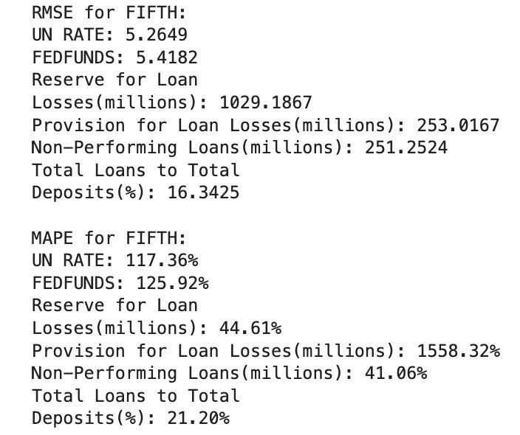
VAR（data of FIFTH THIRD）
Error
The error analysis for FIFTH THIRD shows moderate RMSE and MAPE values, indicating reasonable predictive performance

Slide 21
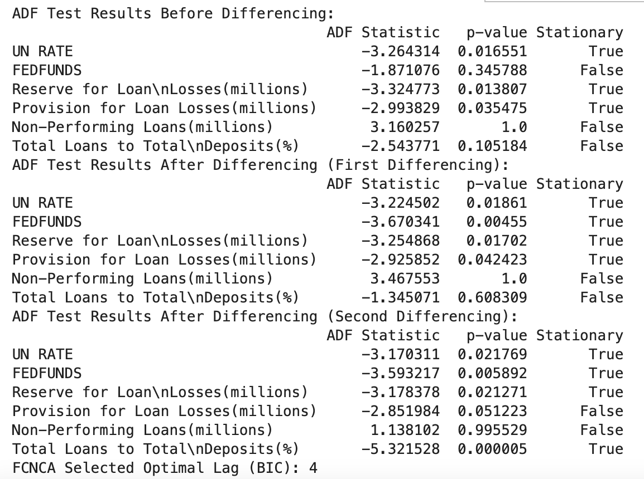
VAR（data of FRCB）
ADF test & use BIC for initial order
The ADF test results show that some variables become stationary after differencing, providing a data foundation for the VAR model.

Slide 22
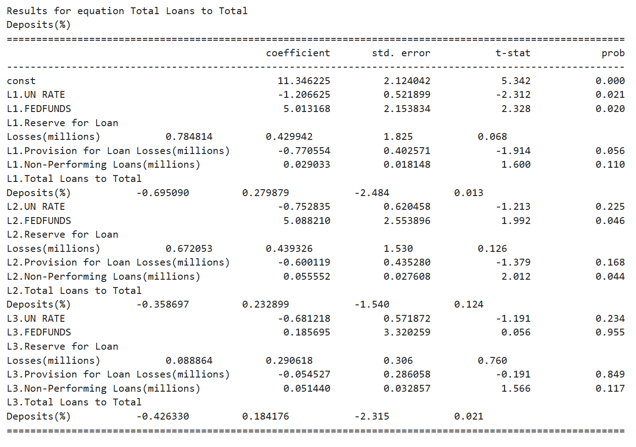
VAR（data of FRCB）
VAR model
Highlighting significant coefficients and statistical relationships, suggesting heightened volatility and liquidity issues compared to other normal banks.

Slide 23
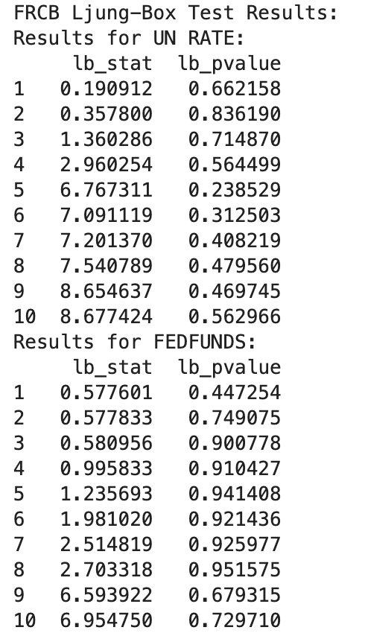
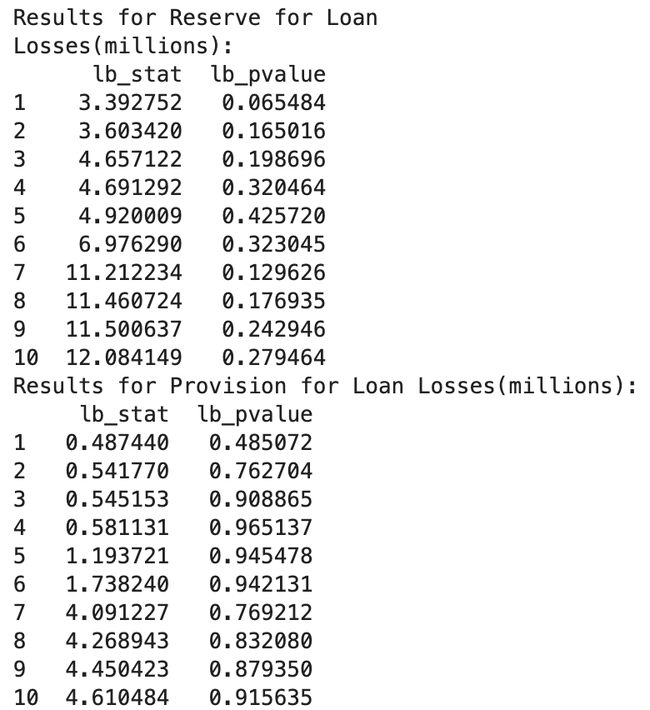
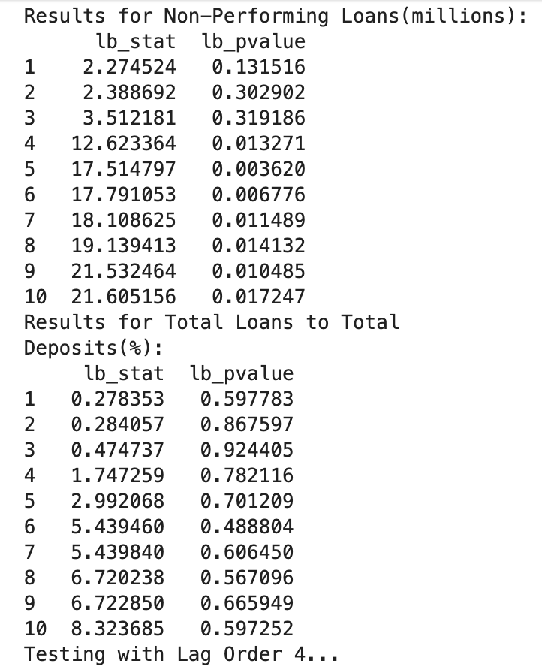
VAR（data of FRCB）
Ljung-Box Test
Ljung-Box tests confirmed residual independence, enhancing model reliability.

Slide 24
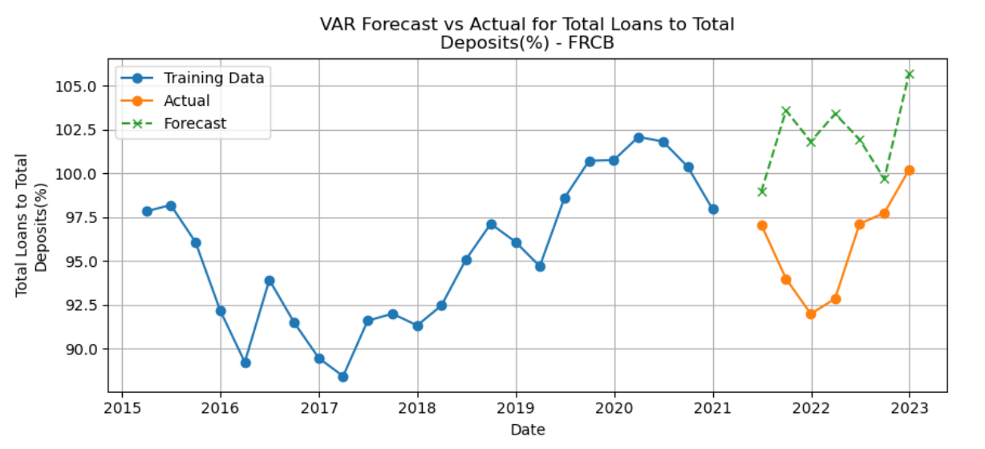
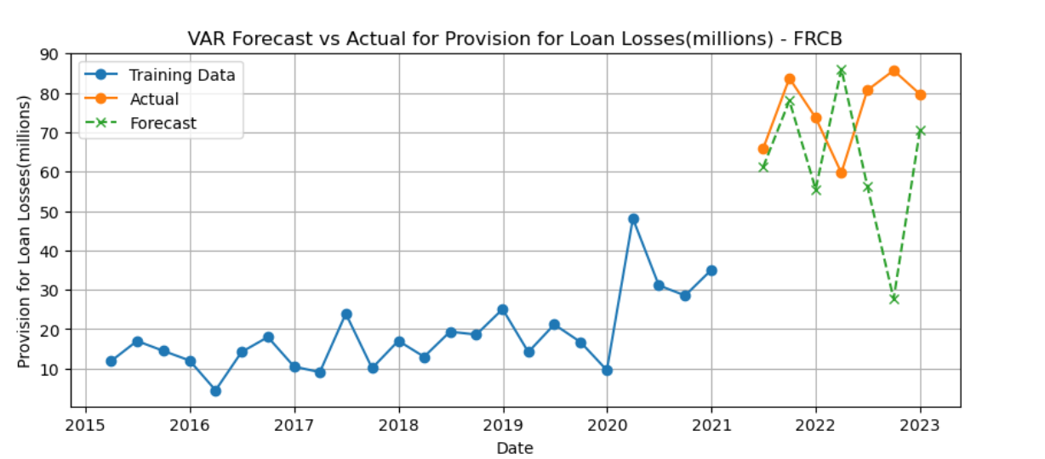
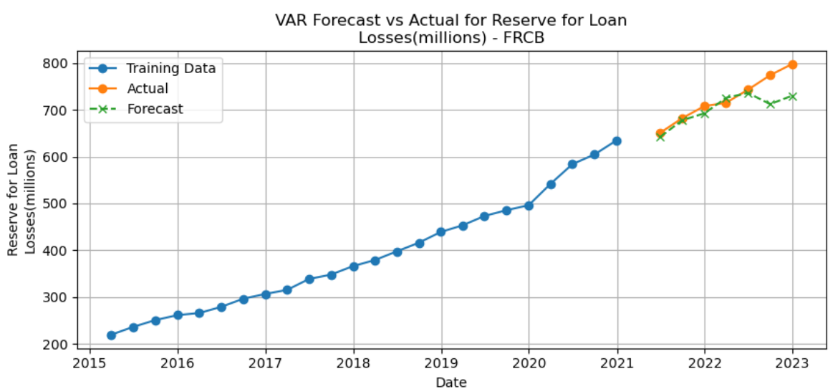
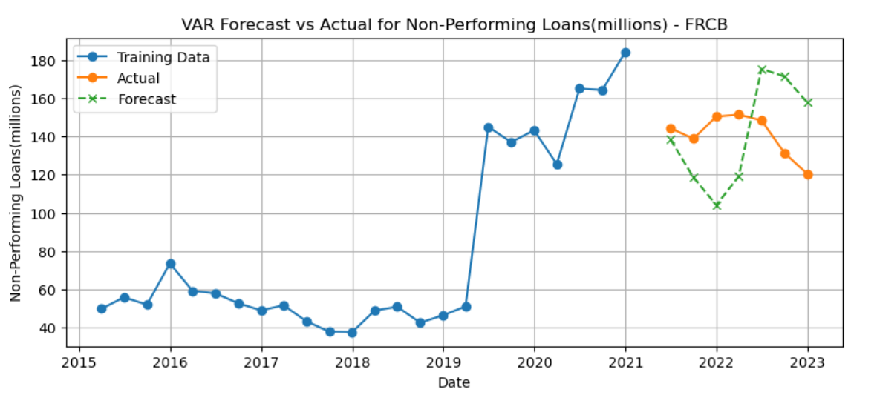
VAR（data of FRCB）
Forecast
Forecasts revealed FRCB’s severe liquidity issues, with significant increases in non-performing loans and loan loss reserves from 2022 to 2023, indicating liquidity shortfalls and high credit risk.
Changing Market Conditions: The loan-to-deposit ratio could be influenced by economic shifts, customer behavior, or bank-specific policies, which the VAR model did not account for.

Slide 25
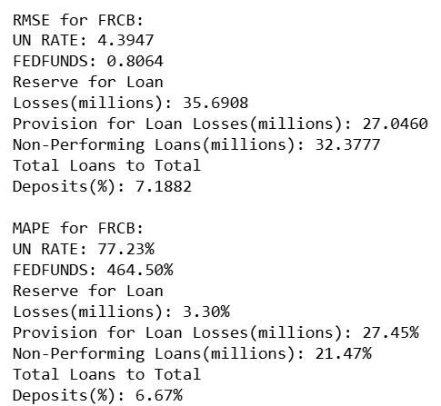
VAR（data of FRCB）
Error
Total Loans to Total Deposits:
- An RMSE of ~7.19% is noteworthy. Given the historical range of this ratio (86.33% to 102.08%).
A MAPE of 6.67% is very good, indicating that the model's predictions for this ratio are highly accurate and reliable

Slide 26
VECM
Methodology
1. Data Cleaning and Preparation:
Cleaning
[80:20] Data Split
2. Selection of Lag Order
Use the same optimal lag as VAR
3. Determine the Cointegration rank
Use the Johansen procedure to choose the smallest number of cointegrating relationships where we fail to reject the null regardless of the number of variables
4. Decide if VECM model can be applied:
r = 0: build VAR model on differenced data
0 < r <= N-1: build VECM
r > N-1: build VAR model on data in levels

Slide 27
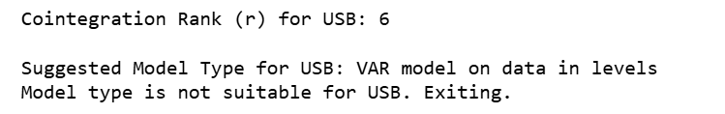
VECM (data of USB)
Model Selection based on Cointegration Rank:

Slide 28
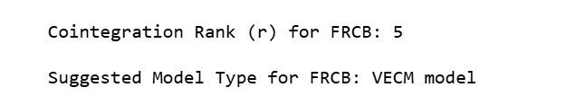
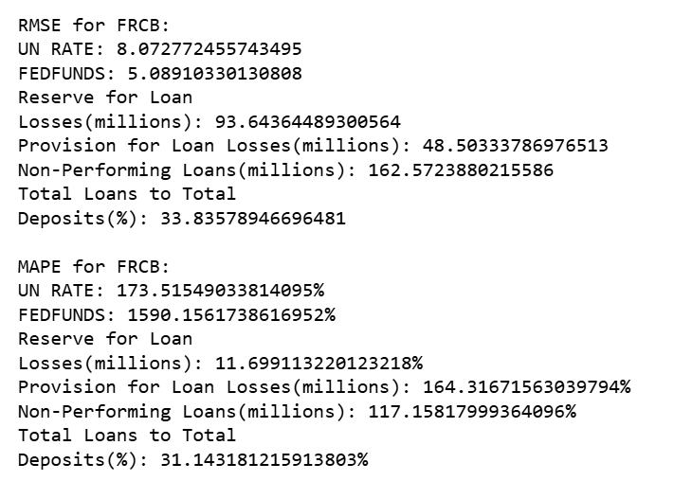
VECM (data of FRCB )
Model Selection based on Cointegration Rank:
Error:
Strengths: Reasonable predictive accuracy for Reserve for Loan Losses and Total Loans to Total Deposits.

Slide 29
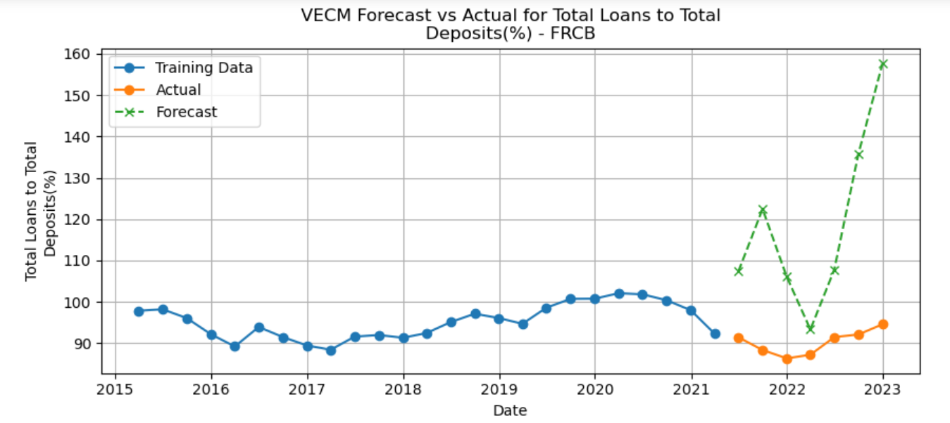
VECM (data of FRCB )
Forecast:
Performance Interpretation:
Overprediction: The VECM model appears to overpredict the ratio significantly for the forecast period.
Possible Explanations:
Economic or Structural Changes: The sudden divergence might reflect economic or bank-specific factors not accounted for in the training period.
Potential Model Limitation:Since VECM models are designed to capture long-term equilibrium relationships, it’s possible that the model struggled with shorter-term variations or structural changes in FRCRB’s loan-to-deposit dynamics.

Slide 30

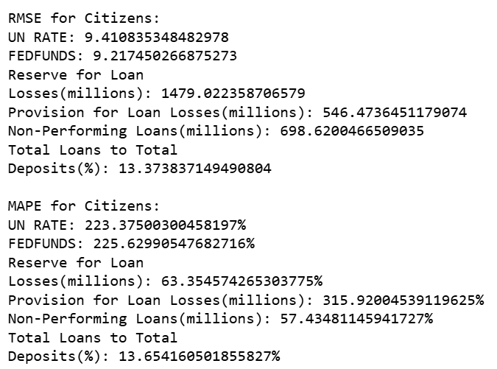
VECM (data of Citizens)
Model Selection based on Cointegration Rank:
Error:
Strengths: Acceptable accuracy for Total Loans to Total Deposits and moderate performance for Non-Performing Loans.

Slide 31
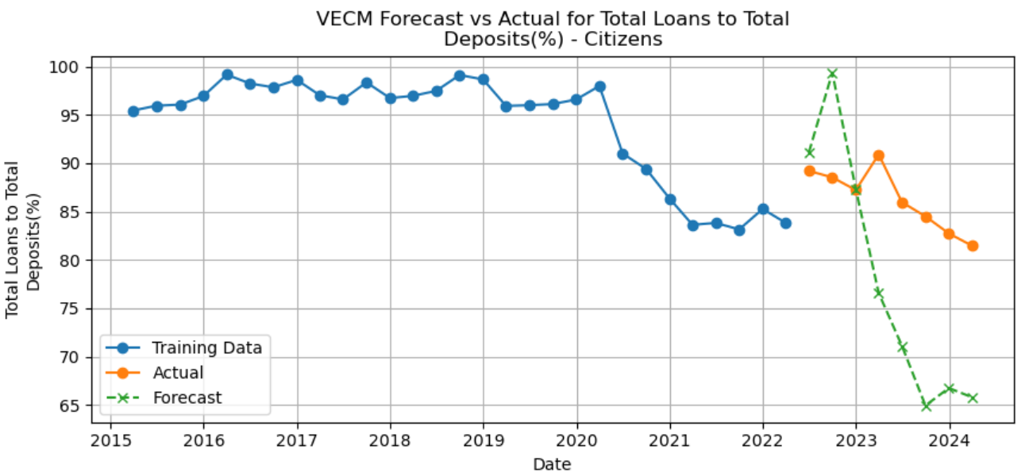
VECM (data of Citizens)
Forecast:
Performance Interpretation:
Underprediction: The VECM model underpredicts the "Total Loans to Total Deposits" ratio, forecasting a sharp decline that does not align with the stable historical trend..
Possible Explanations:
Trend Misinterpretation: The training data shows a gradual decline in recent years, which the VECM model might interpret as a signal for a continuous sharp decline. However, this interpretation appears inaccurate in the test period.
External Economic Factors: Similar to FRCRB, external factors like changes in customer behavior, market conditions, or interest rates may influence the bank’s deposit-loan dynamics and are not reflected in the model.

Slide 32
Comparison of Models for FRCB
Model | RMSE | MAPE | Forecast Accuracy | Key Strengths | Key Weaknesses | Trend Capture | Suitability for Stability Analysis
OLS | 4.05 | 4.16% | High | Simple, interpretable; captures overall trend well | May miss complex patterns or sudden shifts | Good | Suitable; stable model for gradual changes
ARIMA | 4.2 | 3.73% | High | Effective for linear trends and seasonality | Underestimates sharp trend reversals in volatile periods | Good | Suitable; flexible but less adaptive to extreme shifts
VAR | 7.19 | 6.67% | Moderate | Handles multiple interdependent variables well | High error; struggles with short-term fluctuations | Moderate | Less suitable; accuracy dependent on variable relationships
VECM | 33.84 | 31.14% | Low | Suitable for cointegrated series with long-term relationships | High error, significant overestimation of trend | Poor | Unsuitable; fails in short-term forecasting for liquidity ratios

Slide 33
Thanks for Your Attention！

